Slide 1
Keyboard Warrior
Sebastian Cruz - April 8, 2024

Slide 2
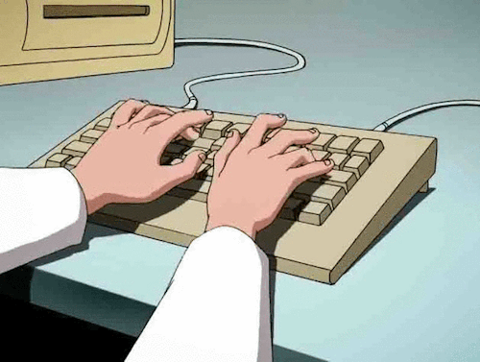
What is it?
A typing video game
Practice typing various words accurately and quickly!
Aimed at improving typing speed, accuracy, and general reaction time!
Notes:
For games, typers. Keyboard enthusiasts

Slide 3
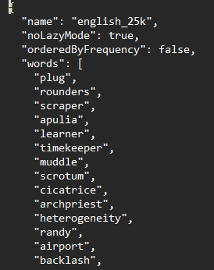
End Goals
Generate randomly chosen words for the player to type
Have an enemy that players will have to attack (with special attack!)
Menu implementations

Slide 4
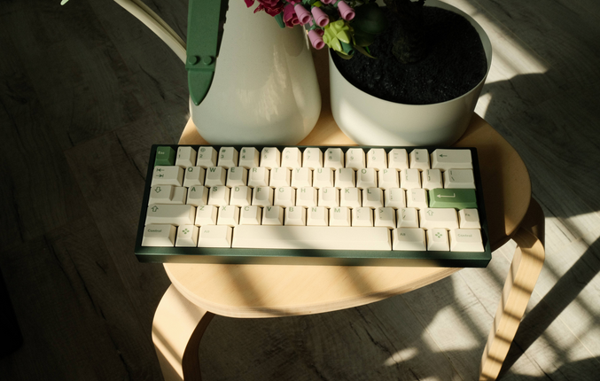
Why this?
I love keyboards A LOT (I have too many…)
Roguelikes are one of my favorite genres
A way to combine two of my passions that can also help others!
An implementation of a typing game in another flavor

Slide 5
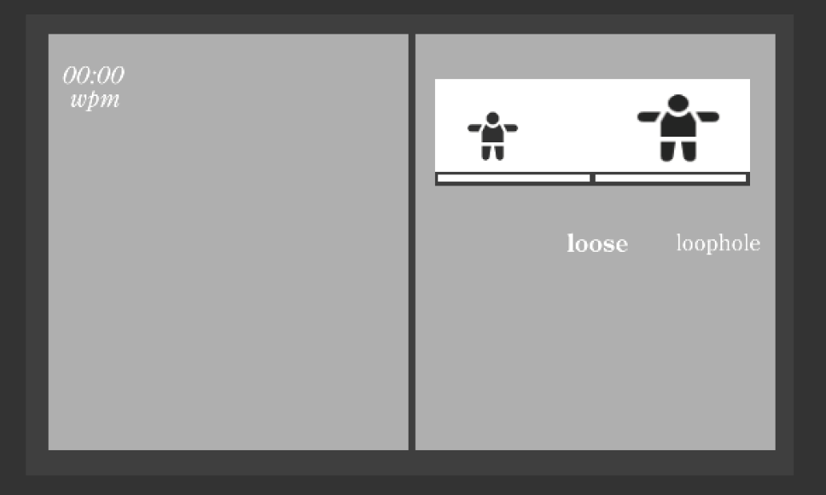
Current state!
General layout
Fighting
Special attacks (WIP)
Simple UI and animations

Slide 6

A little demo…

Slide 7
Project Challenges
Implementing the word popups for Defense
Using Coroutines!
Randomly picking between word lists
Separate probability list!

Slide 8
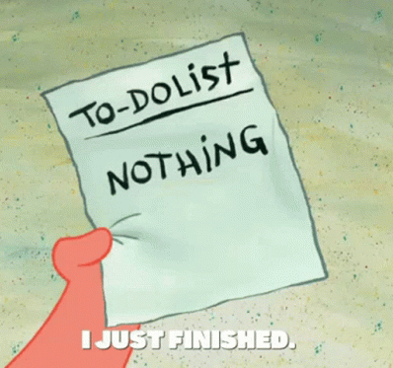
Status Update
Done
Basic player and enemy functionality
Pause Menu functionality
Todo
Enemy special attacks
Main menu
End of combat popup
Progression (stretch goal)

Slide 9
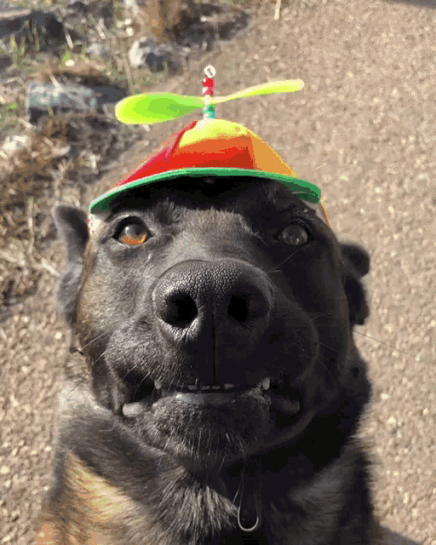
Thank you!

